Slide 1
Theory of Automata (CSC- 402) Semester : Spring 2026 Credit Hours: 3

Slide 2
Theory of Automata Course
Lecture 5

Slide 3
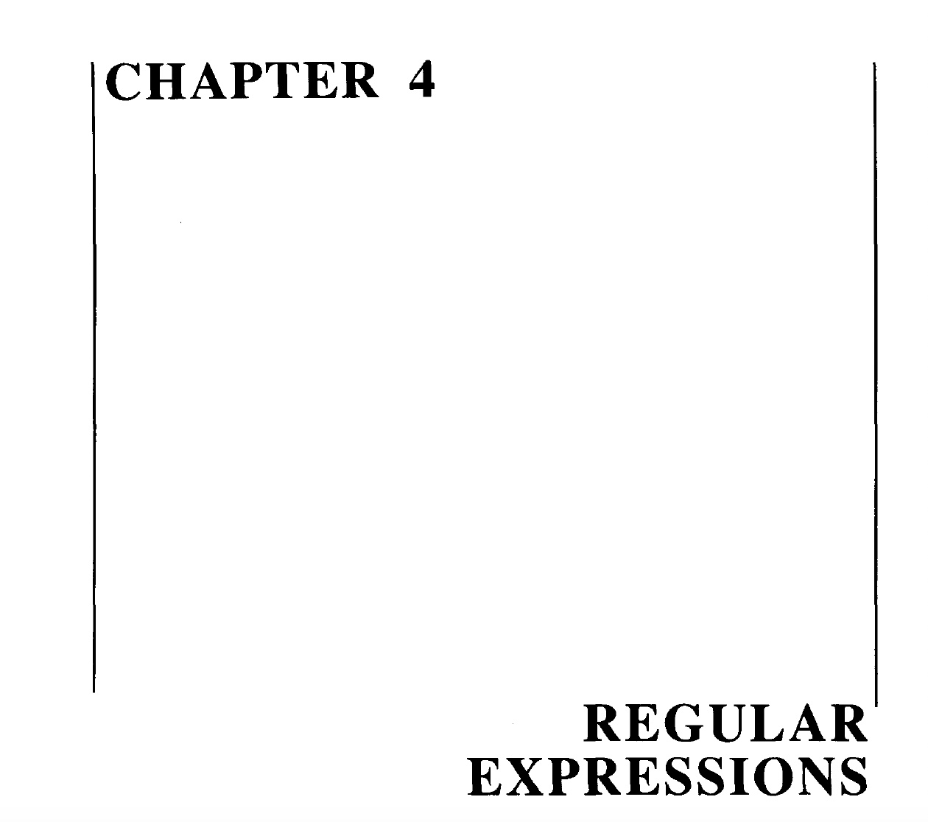

Slide 4
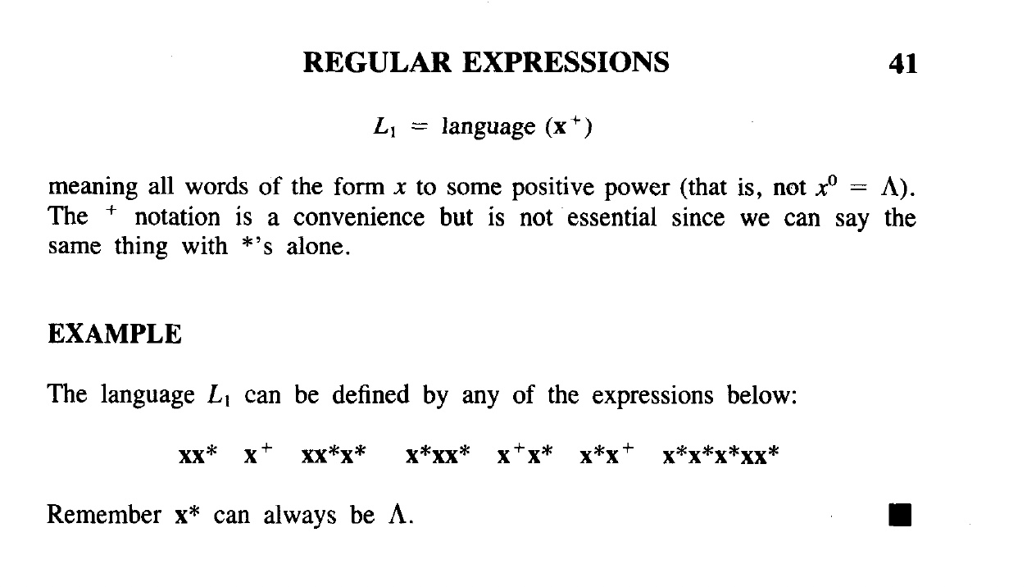

Slide 5
An important example
The Language EVEN-EVEN :
Language of strings, defined over Σ={a, b} having even number of a’s and even number of b’s. i.e.
EVEN-EVEN = {Λ, aa, bb, aaaa,aabb,abab, abba, baab, baba, bbaa, bbbb,…} ,
its regular expression can be written as
(aa+bb+(ab+ba)(aa+bb)*(ab+ba))*

Slide 6
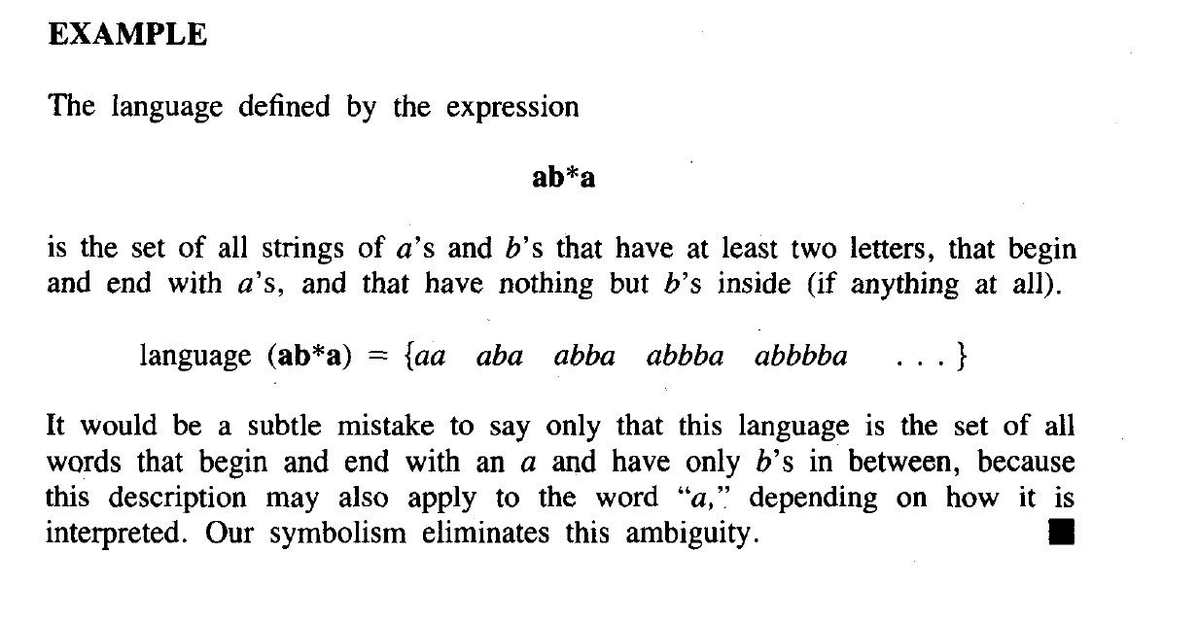

Slide 7
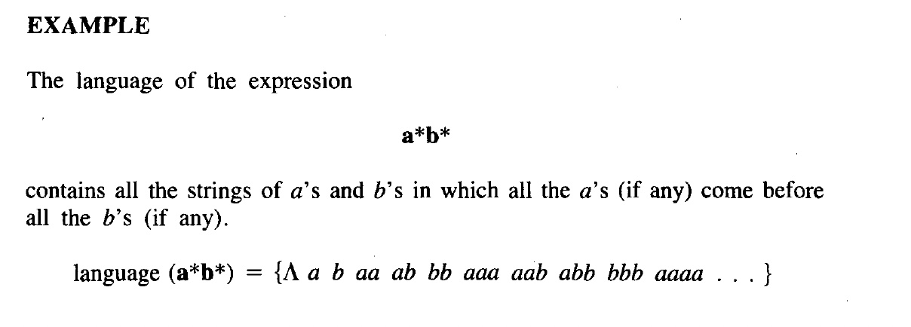

Slide 8
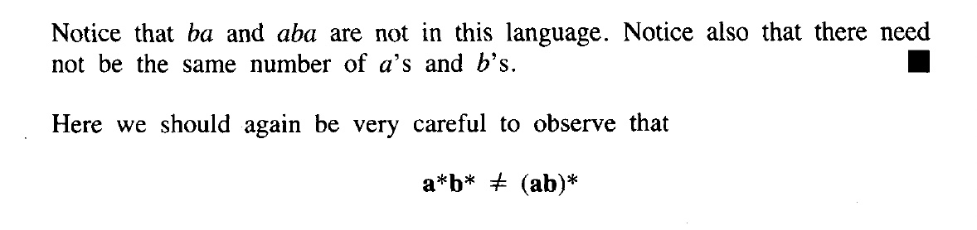

Slide 9
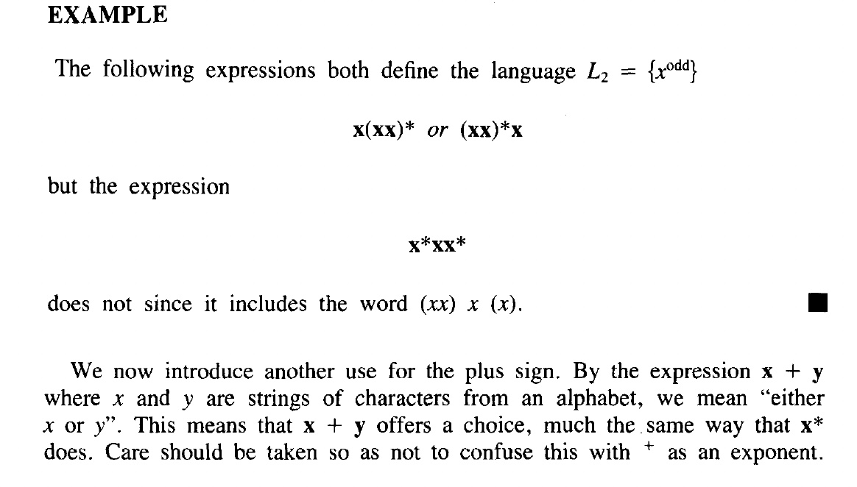

Slide 10
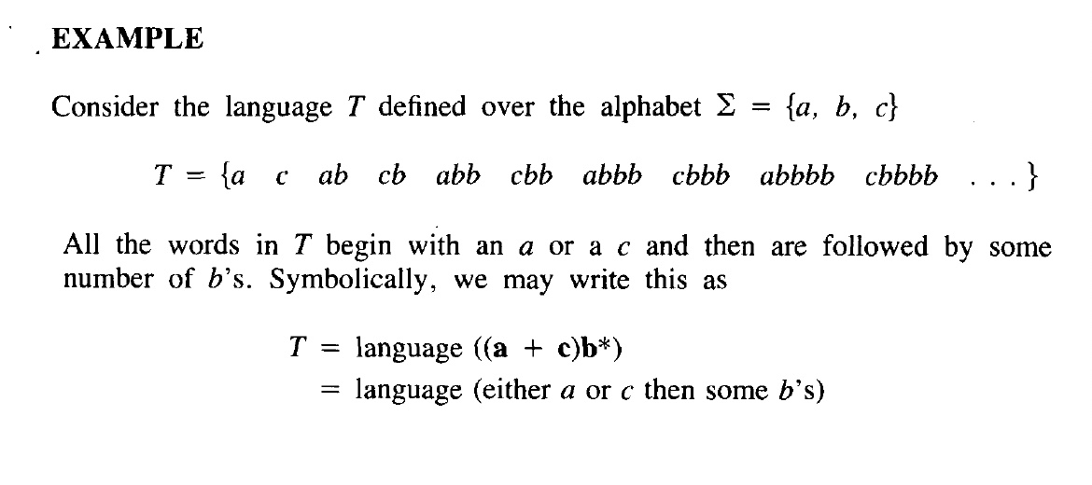

Slide 11
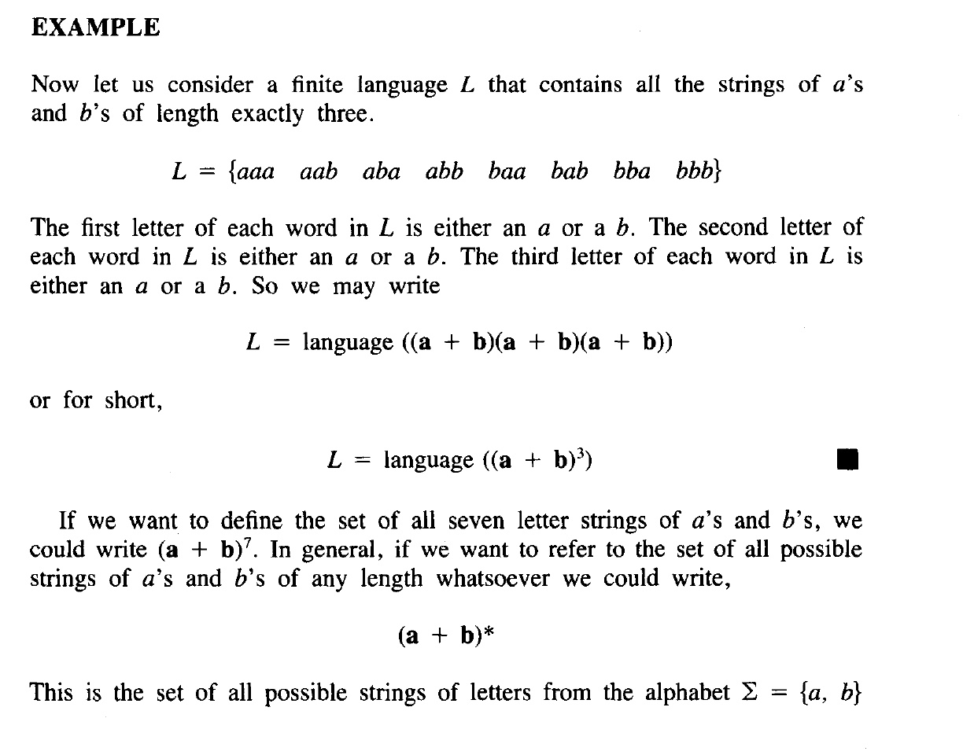

Slide 12
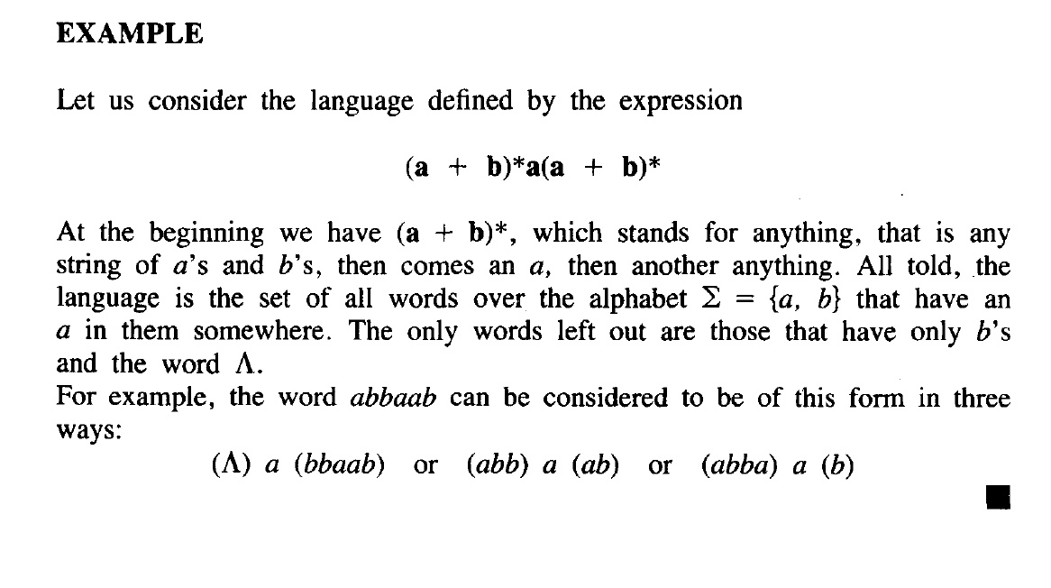

Slide 13
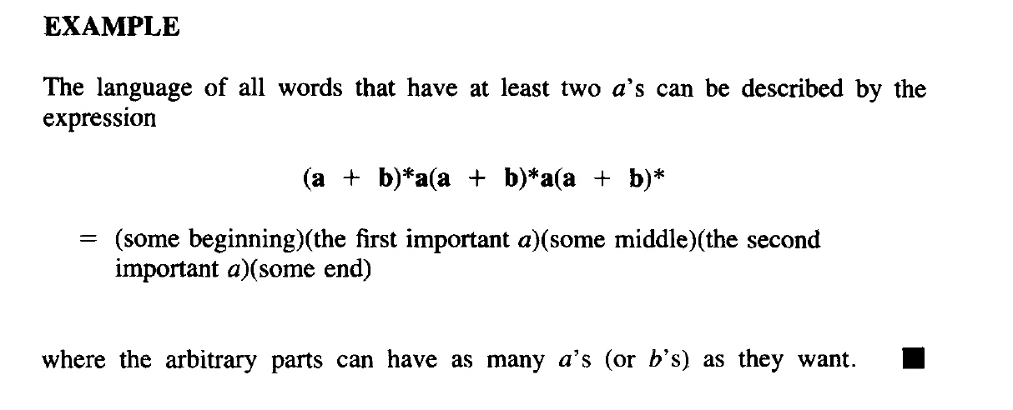

Slide 14
List the possible elements in the following languages
1.) a*b*
2.) (a+b)*
Solve this

Slide 15
Note
It is important to be clear about the difference of the following regular expressions
r₁=a*+b*
r₂=(a+b)*
Here r₁ does not generate any string of concatenation of a and b, while r₂ generates such strings.

Slide 16
Equivalent Regular Expressions
Definition:
Two regular expressions are said to be equivalent if they generate the same language.
Example:
Consider the following regular expressions
r₁= (a + b)* (aa + bb)
r₂= (a + b)*aa + ( a + b)*bb then
both regular expressions define the language of strings ending in aa or bb.

Slide 17
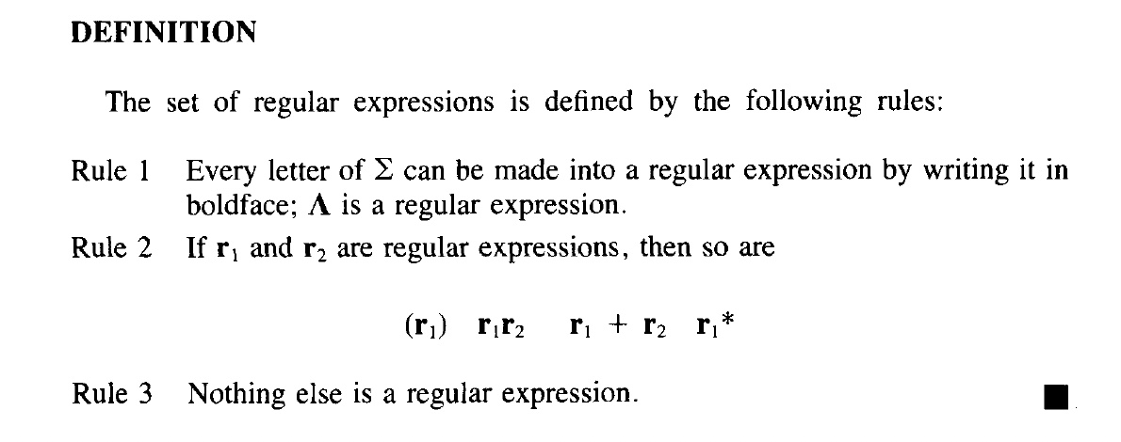

Slide 18
Note
If r₁ =(aa + bb) and r₂=( a + b) then
r₁+r₂ =(aa + bb) + (a + b) =(a + b + aa + bb)
r₁r₂ =(aa + bb) (a + b) =(aaa + aab + bba + bbb)
(r₁)* =(aa + bb)*

Slide 19
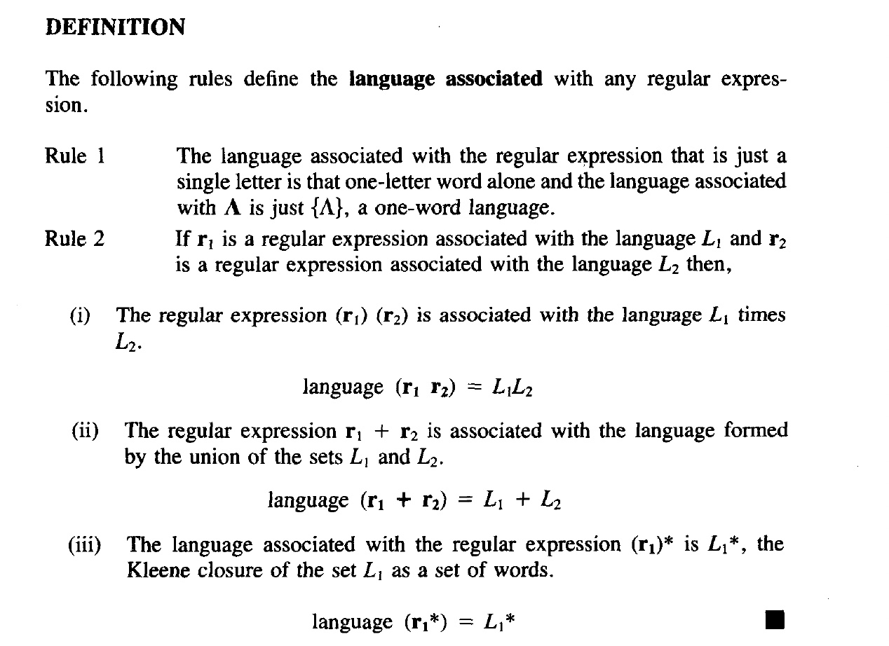

Slide 20
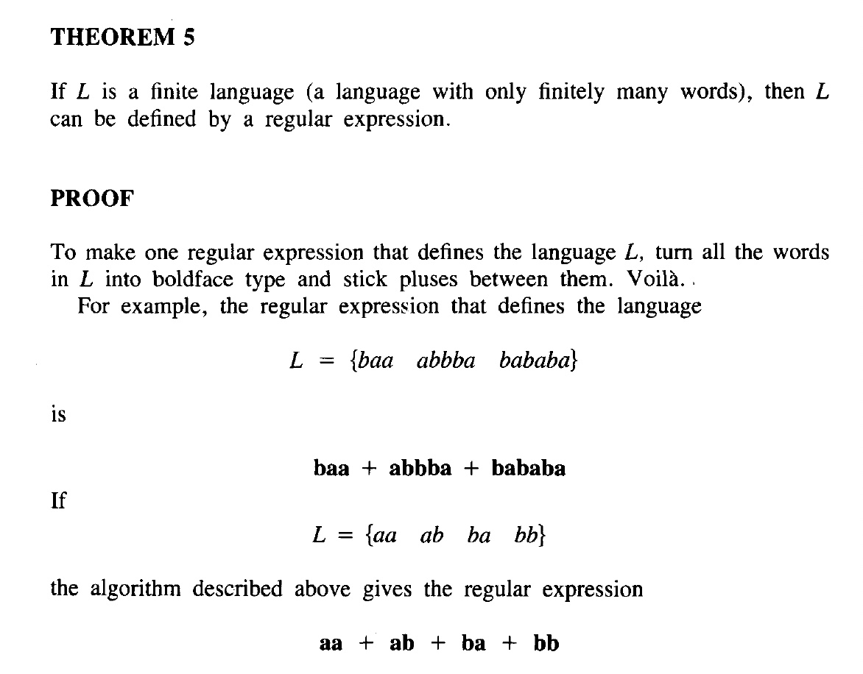

Slide 21
End of Lecture

